Slide 1
Vector Model Updated 3/27
I_MAX_AGE=60
Other Improvements

Slide 2
Notes
Don’t compare Aging versus No Aging
Aging causes vectors to die
No Aging has 13% more vectors
Changes include:
I_MAX_AGE from 150 to 60
Removed not needed multinomial_approx() call
Changed oviposition timer to an integer to get rid of calling round()
Reduced some calls to QueryInterface()
Changed VectorPopulation so that we are caching a pointer to simulation config and params() just returns that

Slide 3
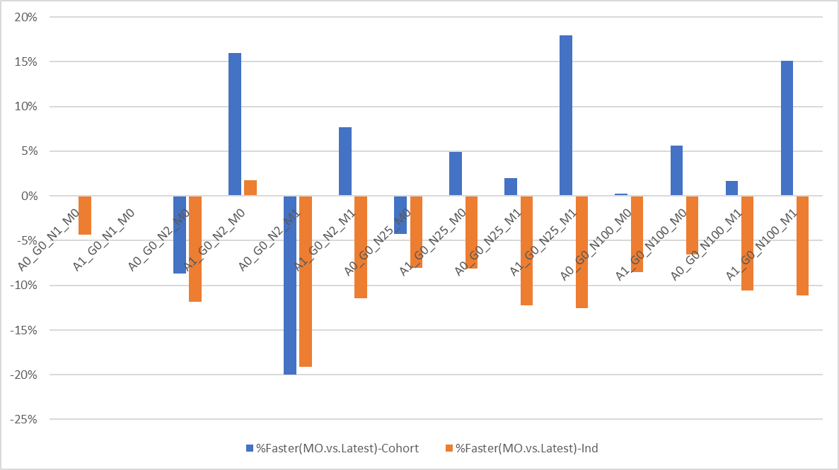
10K Vectors Per Node
2-15 seconds
100-300 seconds
450-1250 seconds

Slide 4
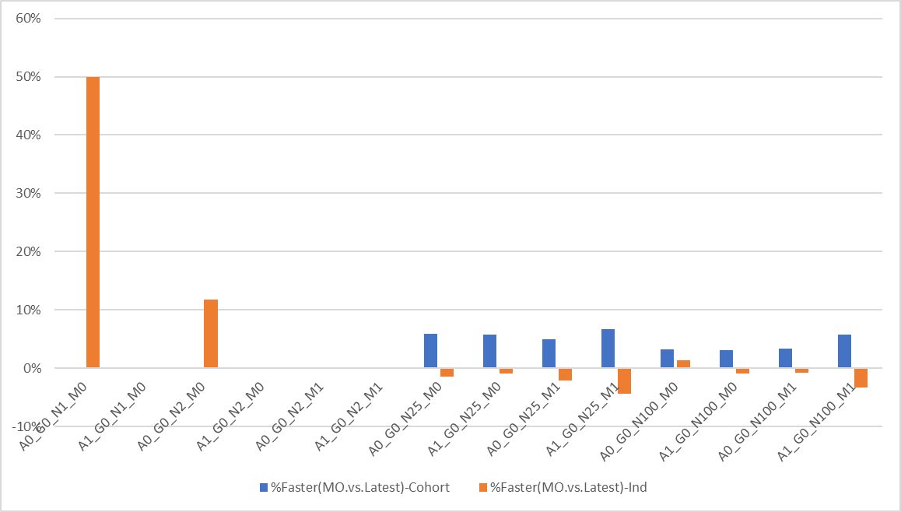
1K Vectors Per Node
< 5 seconds
35-80 seconds
150-325 seconds

Slide 5
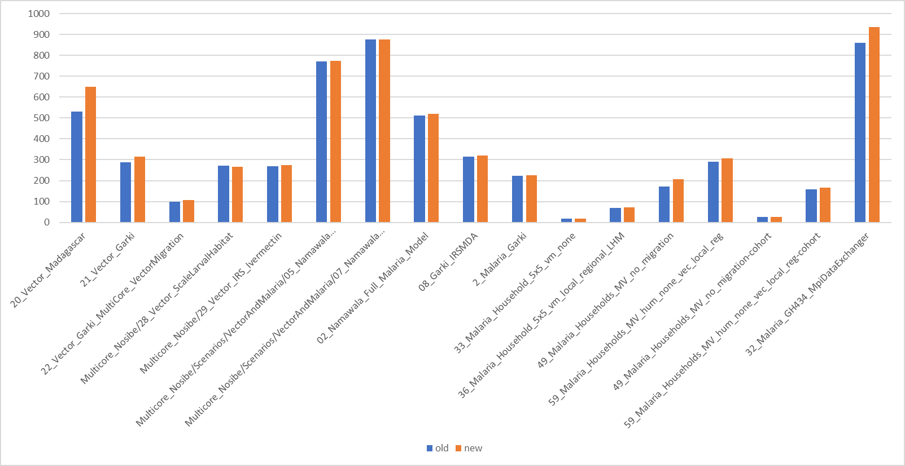
Regression Tests - Times

Slide 6
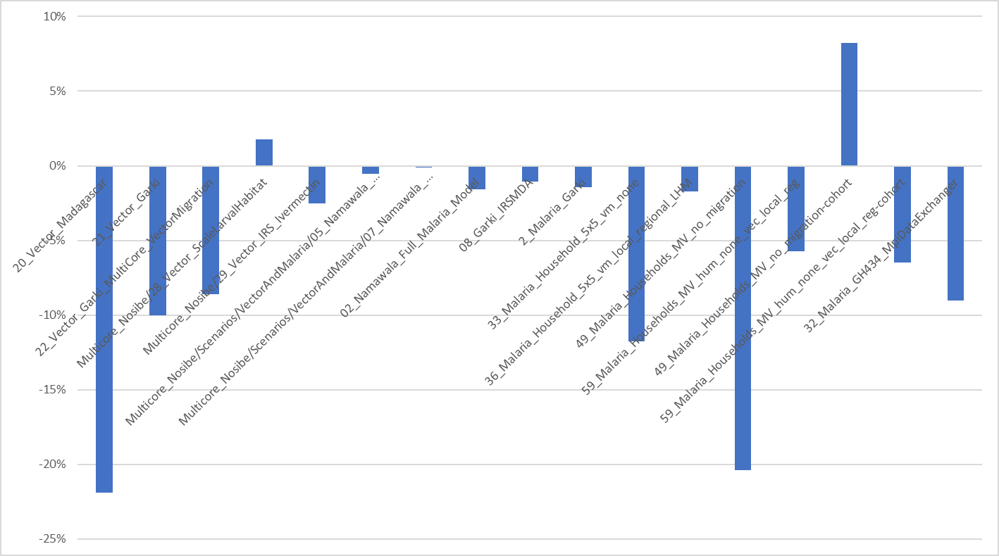
Regression Tests – New % Faster

Slide 7
Conclusion
Cohort ~ 10% faster
Individual ~10% slower
Things Making it Slower
New Genetic features
Trait Modifiers
Std::map used for genomes and counting
Numerous bug fixes
Using binomial instead of truncating
Better management of gestating vectors

Slide 8
Vector Model Update Performance
March 22, 2019

Slide 9
Scenarios
Constant Climate
Days_Between_Feeds = 3
One specie
Aging On/Off
Genes 0 or 2x2
1, 2, 25, 100 Nodes
Migration On/Off
~100,000 Vectors/Node

Slide 10
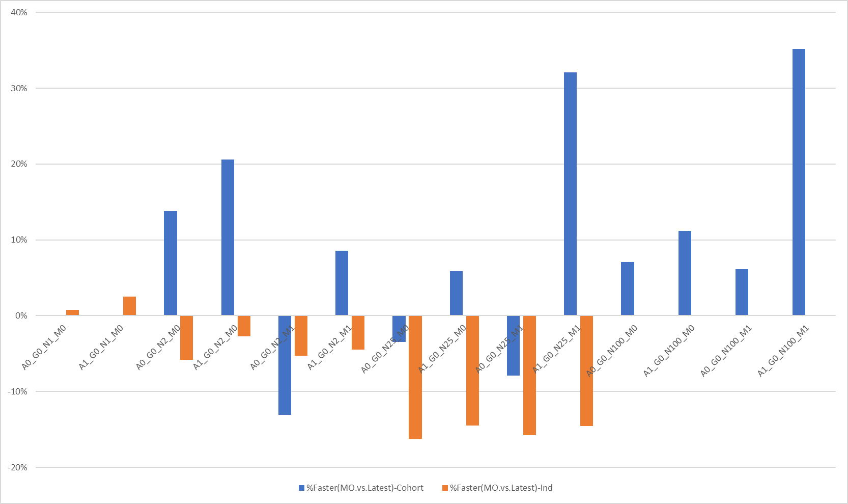
Malaria-Ongoing vs Latest – “% Faster”
Cohort
Cohort is 0%
No Individual runs with 100 Nodes
Individual

Slide 11
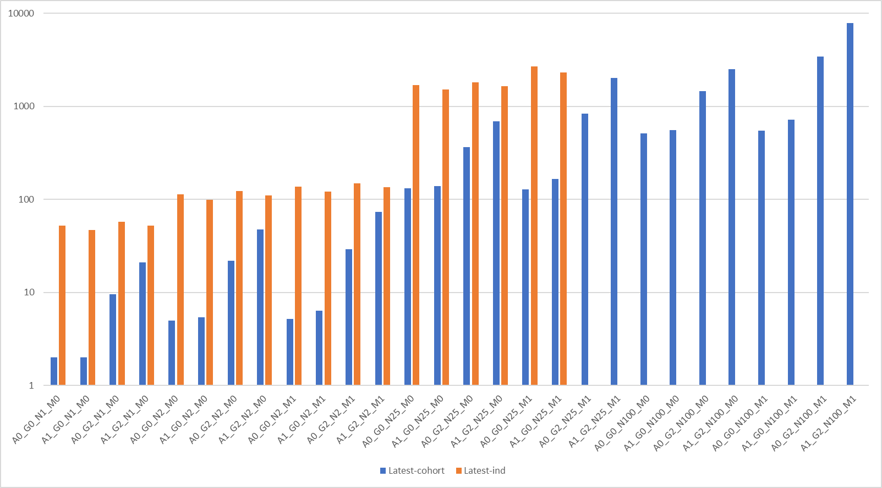
Latest – Cohort vs Individual
Logarithmic

